Slide 1
3
APPLICATIONS OF
DIFFERENTIATION

Slide 2
3.1
Maximum and Minimum Values

Slide 3
Maximum and Minimum Values
Some of the most important applications of differential calculus are optimization problems, in which we are required to find the optimal (best) way of doing something.
Here are examples of such problems:
What is the shape of a can that minimizes manufacturing costs?
What is the maximum acceleration of a space shuttle?
These problems can be reduced to finding the maximum or minimum values of a function. Let’s first explain exactly what we mean by maximum and minimum values..

Slide 4
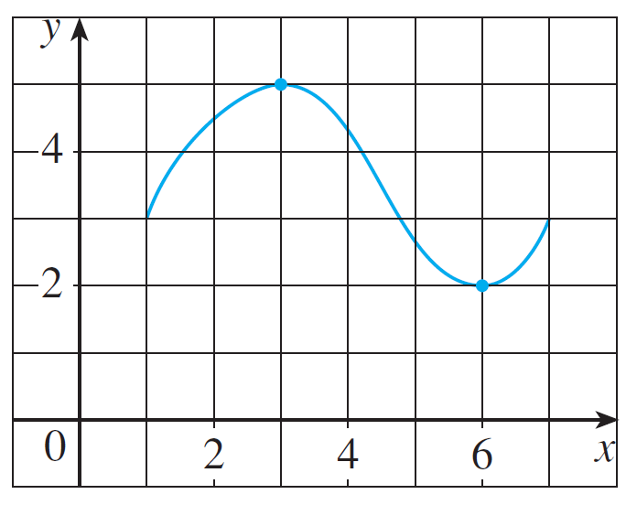
Maximum and Minimum Values
We see that the highest point on the graph of the function f shown in Figure 1 is the point (3, 5).
In other words, the largest value of f is f (3) = 5. Likewise, the smallest value is f (6) = 2. We say that f (3) = 5 is the absolute maximum of f and f (6) = 2 is the absolute minimum.
Figure 1

Slide 5
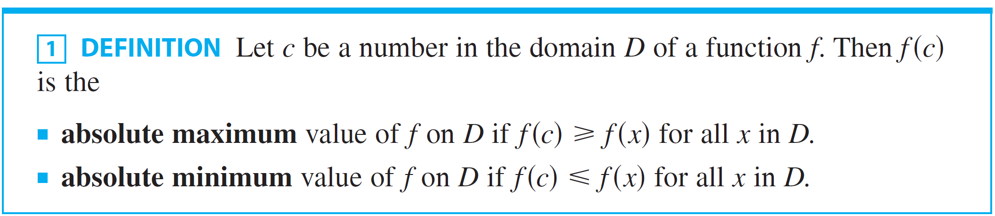
Maximum and Minimum Values
In general, we use the following definition.
An absolute maximum or minimum is sometimes called a global maximum or minimum.
The maximum and minimum values of f are called extreme values of f.

Slide 6
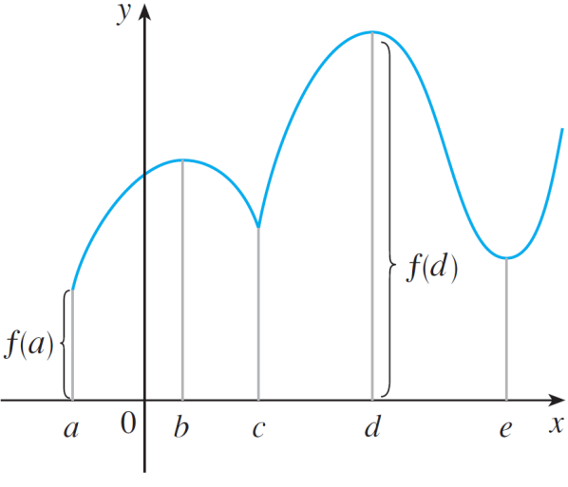
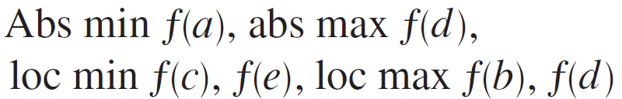
Maximum and Minimum Values
Figure 2 shows the graph of a function f with absolute maximum at d and absolute minimum at a.
Note that (d, f (d )) is the highest point on the graph and (a, f (a)) is the lowest point.
Figure 2

Slide 7
Maximum and Minimum Values
In Figure 2, if we consider only values of x near b [for instance, if we restrict our attention to the interval (a, c)], then f (b) is the largest of those values of f (x) and is called a local maximum value of f.
Likewise, f (c) is called a local minimum value of f because f (c) ≤ f (x) for x near c [in the interval (b, d), for instance].
The function f also has a local minimum at e.

Slide 8
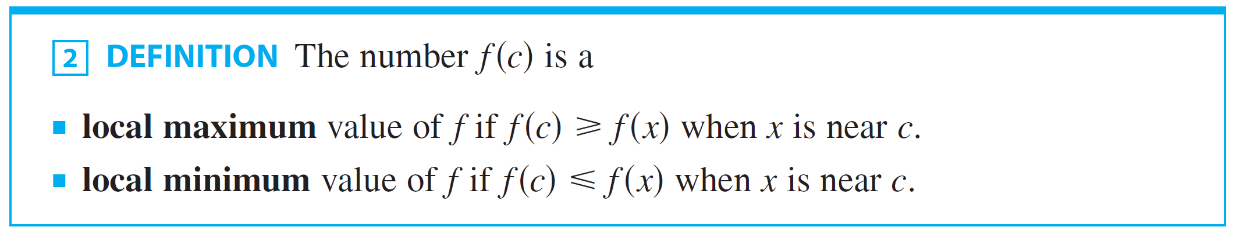
Maximum and Minimum Values
In general, we have the following definition.
In Definition 2 (and elsewhere), if we say that something is true near c, we mean that it is true on some open interval containing c.

Slide 9
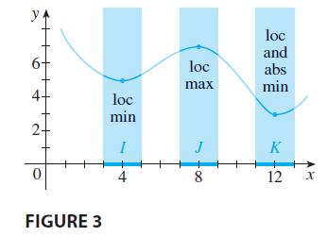
Maximum and Minimum Values
For instance, in Figure 3 we see that f(4)=5 is a local minimum because it’s the smallest value of f on the interval I.
It’s not the absolute minimum because f(x) takes smaller values when x is near 12 (in the interval K, for instance). In fact, f (12)=3 is both a local minimum and the absolute minimum. Similarly, f(8) =7 is a local maximum, but not the absolute maximum because f takes larger values near 1.

Slide 10
Example 1
The function f(x) = cos x takes on its (local and absolute) maximum value of 1 infinitely many times—since cos 2nπ = 1 for any integer n and – 1 ≤ cos x ≤ 1 for all x.
Likewise, cos (2n + 1)π = – 1 is its minimum value—where n is any integer.

Slide 11
Example 2
If f(x) = x², then f(x) ≥ f(0) because x² ≥ 0 for all x.
Therefore, f(0) = 0 is the absolute (and local) minimum value of f.
This corresponds to the fact that the origin is the lowest point on the parabola y = x². (See Figure 2.)
However, there is no highest point on the parabola.
So, this function has no maximum value.

Slide 12
Example 3
From the graph of the function f(x) = x³, shown in Figure 3, we see that this function has neither an absolute maximum value nor an absolute minimum value.
In fact, it has no local extreme values either.

Slide 13
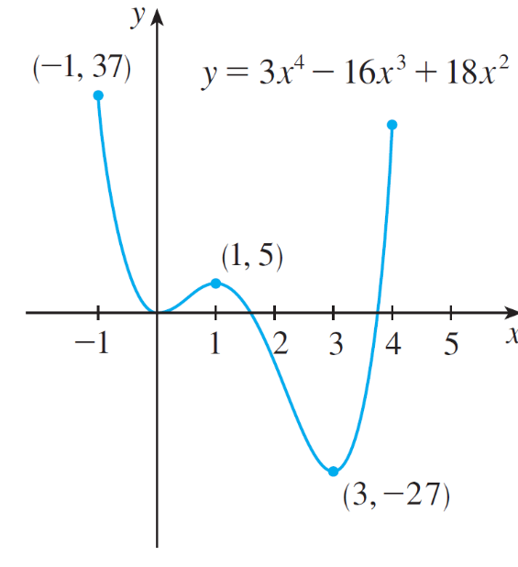
Example 4
The graph of the function
is shown in Figure 6.
Figure 6

Slide 14
Example 4
You can see that f (1) = 5 is a local maximum, whereas the absolute maximum is f (–1) = 37. (This absolute maximum is not a local maximum because it occurs at an endpoint.)
Also, f (0) = 0 is a local minimum and f (3) = –27 is both a local and an absolute minimum.
Note that f has neither a local nor an absolute maximum at x = 4.

Slide 15
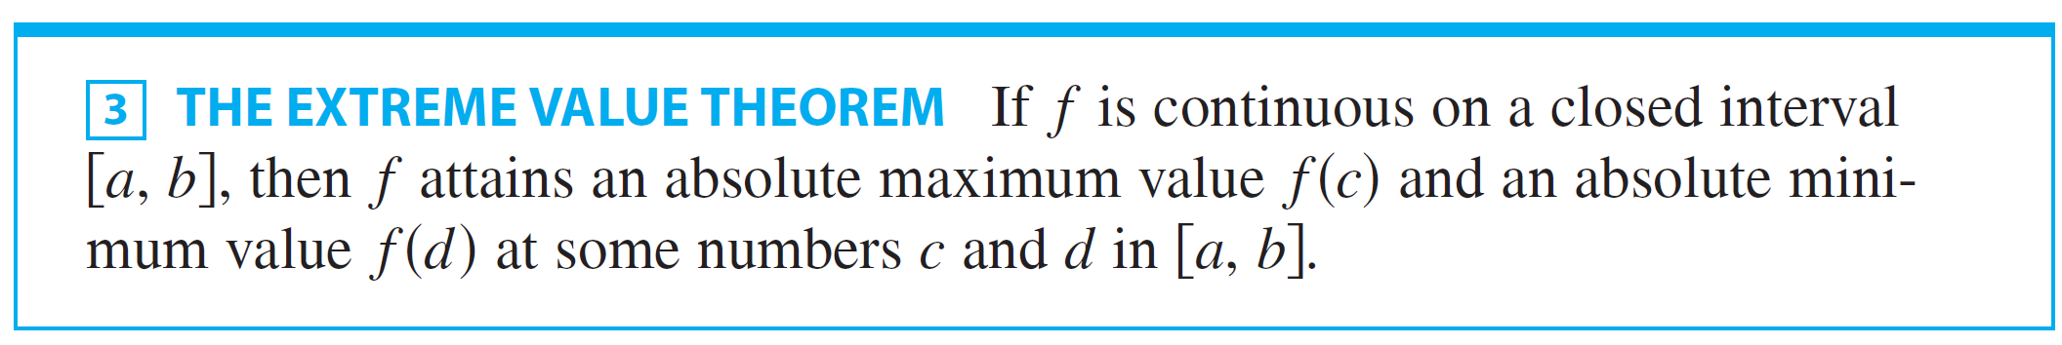
Maximum and Minimum Values
We have seen that some functions have extreme values, whereas others do not. The following theorem gives conditions under which a function is guaranteed to possess extreme values.

Slide 16
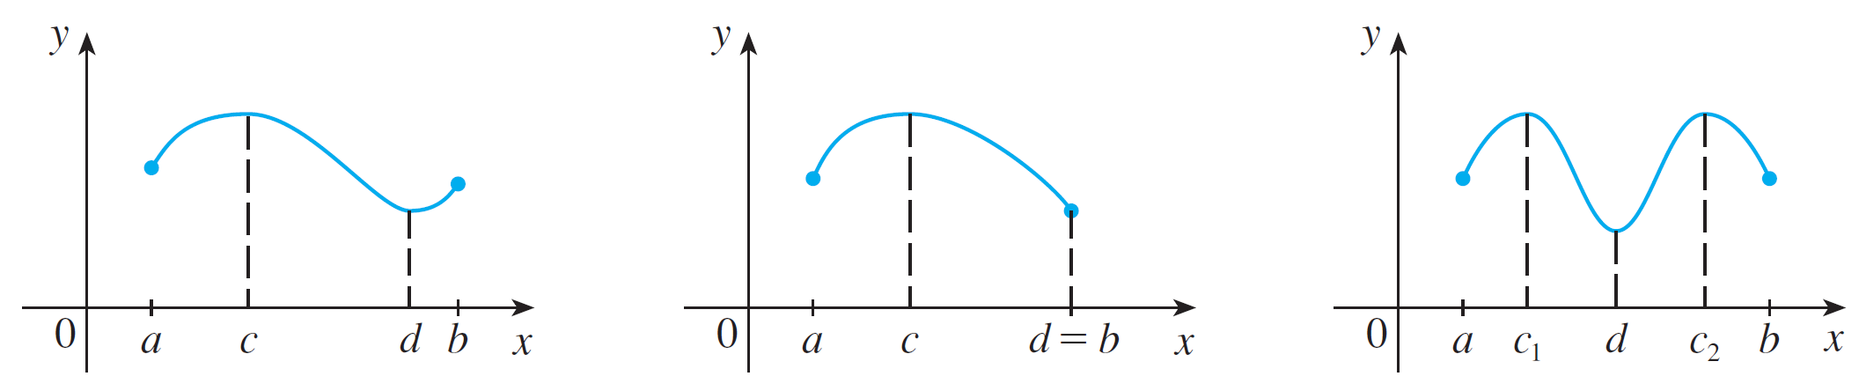
Maximum and Minimum Values
The Extreme Value Theorem is illustrated in Figure 7.
Note that an extreme value can be taken on more than once.
Figure 7

Slide 17
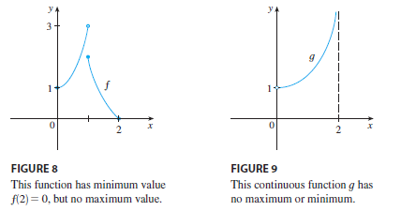
Maximum and Minimum Values
Figures 8 and 9 show that a function need not possess extreme values if either hypothesis (continuity or closed interval) is omitted from the Extreme Value Theorem.

Slide 18
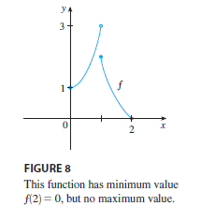
Maximum and Minimum Values
The function f whose graph is shown in Figure 8 is defined on the closed interval [0,2] but has no maximum value. [Notice that the range of f is [0,3). The function takes on values arbitrarily close to 3, but never actually attains the value 3.] This does not
contradict the Extreme Value
Theorem because f is
not continuous.

Slide 19
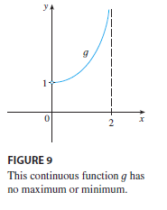
Maximum and Minimum Values
The function g shown in Figure 9 is continuous on the open interval (0,2) but has neither a maximum nor a minimum value. The range of g is (1, ). The function takes on arbitrarily large values.]
This does not contradict the
Extreme Value Theorem
because the
Interval (0,2) is not closed.

Slide 20
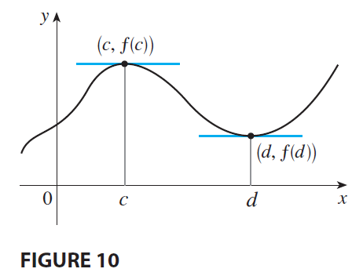
Maximum and Minimum Values
The Extreme Value Theorem says that a continuous function on a closed interval has a maximum value and a minimum value, but it does not tell us how to find these extreme values.
Figure 10 shows that
the graph of a function f
with a local maximum
at c and a local minimum at d.

Slide 21
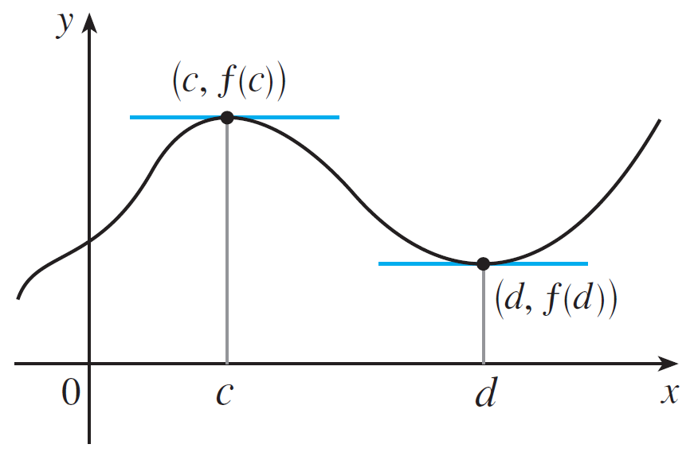
Maximum and Minimum Values
Figure 10 shows the graph of a function f with a local maximumat c and a local minimum at d.
It appears that at the maximum and minimum points the tangent lines are horizontal and therefore each has slope 0.
Figure 10

Slide 22
Maximum and Minimum Values
It appears that at the maximum and minimum points the tangent lines are horizontal and therefore each has slope 0.
We know that the derivative is the slope of the tangent line, so it appears that f ′(c) = 0
and f ′(d) = 0.
Figure 10

Slide 23
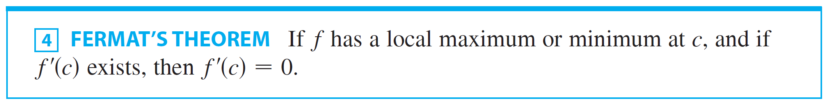
Maximum and Minimum Values
The following theorem says that this is always true for differentiable functions.
PROOF
Suppose, for the sake of definiteness, that f has a local maximum at c.
Then, according to Definition 2, f(c) ≥ f(x) if x is sufficiently close to c.

Slide 24
PROOF
This implies that, if h is sufficiently close to 0, with h being positive or negative, then f(c) ≥ f(c + h) and therefore f(c + h) – f(c) ≤ 0
We can divide both sides of an inequality by a positive number.
Thus, if h > 0 and h is sufficiently small, we have:

Slide 25
PROOF
Taking the right-hand limit of both sides of this inequality (using Theorem 2 in Section 2.3), we get:
However, since f ’(c) exists, we have:
So, we have shown that f ’(c) ≤ 0.

Slide 26
PROOF
If h < 0, then the direction of the inequality in Equation 5 is reversed when we divide by h:
So, taking the left-hand limit, we have:

Slide 27
PROOF
We have shown that f ’(c) ≥ 0 and also that f ’(c) ≤ 0.
Since both these inequalities must be true, the only possibility is that f ’(c) = 0.
We have proved the theorem for the case of a local maximum.
The case of a local minimum can be proved in a similar manner.
Alternatively, we could use Exercise 58 to deduce it from the case we have just proved.

Slide 28
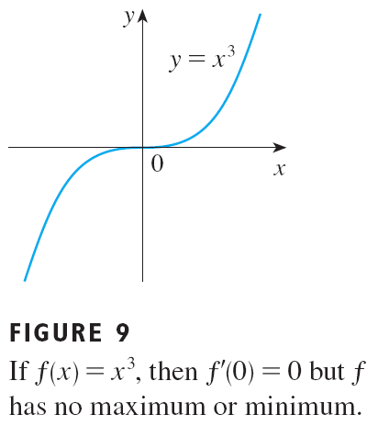
FERMAT’S THEOREM
Although Fermat’s Theorem is very useful, we have to guard against reading too much into it.
If f(x) = x³, then f ’(x) = 3x², so f ’(0) = 0.
However, f has no maximum or minimum at 0—as you can see from the graph.
Alternatively, observe that x³ > 0 for x > 0 but x³ < 0 for x < 0.

Slide 29
FERMAT’S THEOREM
The fact that f ’(0) = 0 simply means that the curve y = x³ has a horizontal tangent at (0, 0).
Instead of having a maximum or minimum at (0, 0), the curve crosses its horizontal tangent there.

Slide 30
FERMAT’S THEOREM
The function f(x) = |x| has its (local and absolute) minimum value at 0.
However, that value can’t be found by setting f ’(x) = 0. (See Figure 10)
This is because—as shown in Example 5 in Section 2.2—f ’(0) does not exist.

Slide 31
WARNING
Examples 5 and 6 show that we must be careful when using the theorem.
Example 5 demonstrates that, even when f ’(c) = 0, there need not be a maximum or minimum at c.
In other words, the converse of the theorem is false in general.
Furthermore, there may be an extreme value even when f ’(c) does not exist (as in Example 6).

Slide 32

Maximum and Minimum Values
Fermat’s Theorem suggests that we should at least start looking for extreme values of f at the numbers c where
f’(c)=0 or where f’(c) does not exist. Such numbers are given a special name.

Slide 33

Example 5
Find the critical numbers of

Slide 34
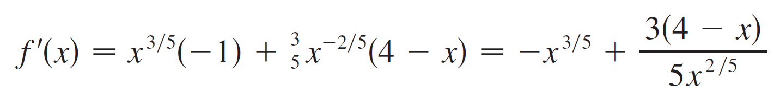
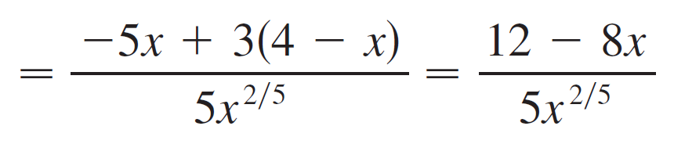
Example 5 – Solution
SOLUTION:
The Product Rule gives

Slide 35


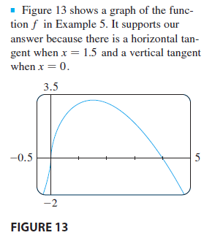

Example 5 – Solution
cont’d
[The same result could be obtained by first writing
.] Therefore
that is, and f ′(x) does
not exist when x = 0. Thus, the
critical numbers are and 0.

Slide 36
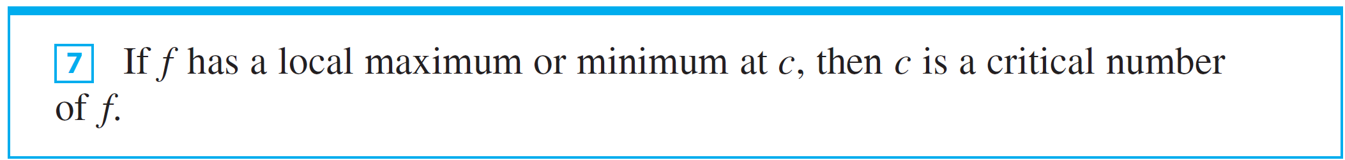

Maximum and Minimum Values
In terms of critical numbers, Fermat’s Theorem can be rephrased as follows (compare Definition 6 with Theorem 4):
To find an absolute maximum or minimum of a continuous function on a closed interval, we note that either it is local [in which case it occurs at a critical number by ] or it occurs at an endpoint of the interval.

Slide 37
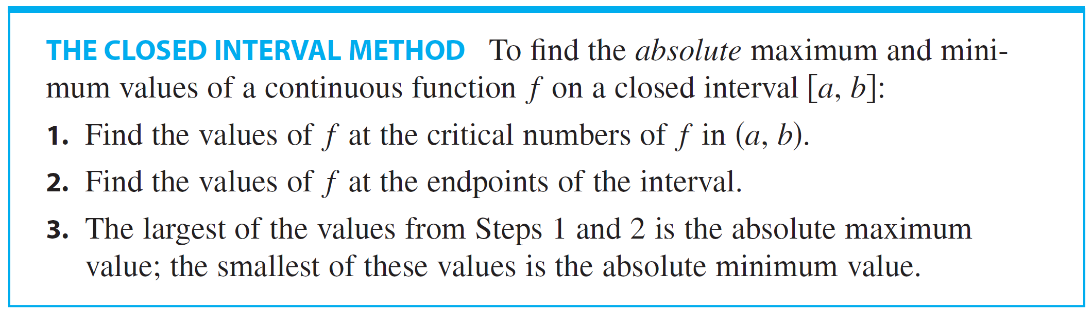
Maximum and Minimum Values
Thus the following three-step procedure always works.

Slide 38
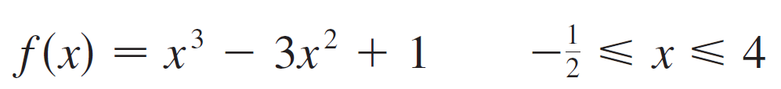
Example 6
Find the absolute maximum and minimum values of the function

Slide 39

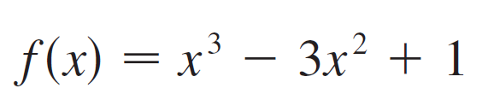
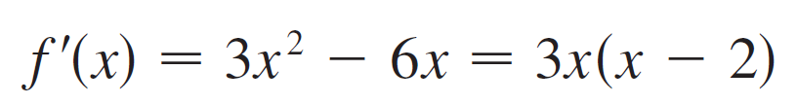

Example 6 – Solution
SOLUTION: Since f is continuous on we can use the Closed Interval Method:
Since f ′(x) exists for all x, the only critical numbers of f occur when f ′(x) = 0, that is, x = 0 or x = 2. Notice that each of these critical numbers lies in the interval

Slide 40
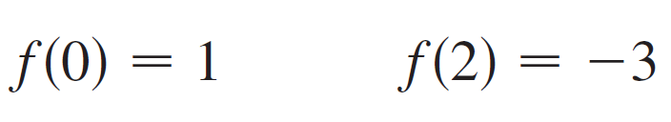
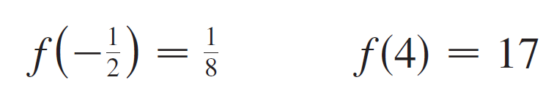
Example 6 – Solution
cont’d
The values of f at these critical numbers are
The values of f at the endpoints of the interval are
Comparing these four numbers, we see that the absolute maximum value is f (4)=17 and the absolute minimum value is f(2)= -3.

Slide 41
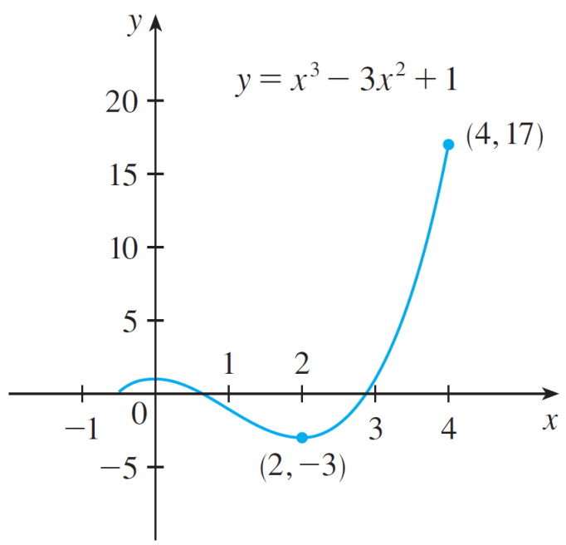
Example 6 – Solution
cont’d
Note that in this example the absolute maximum occurs at an endpoint, whereas the absolute minimum occurs at a critical number.
The graph of f is sketched in Figure 14.
Figure 14

